Slide 1


Slide 2
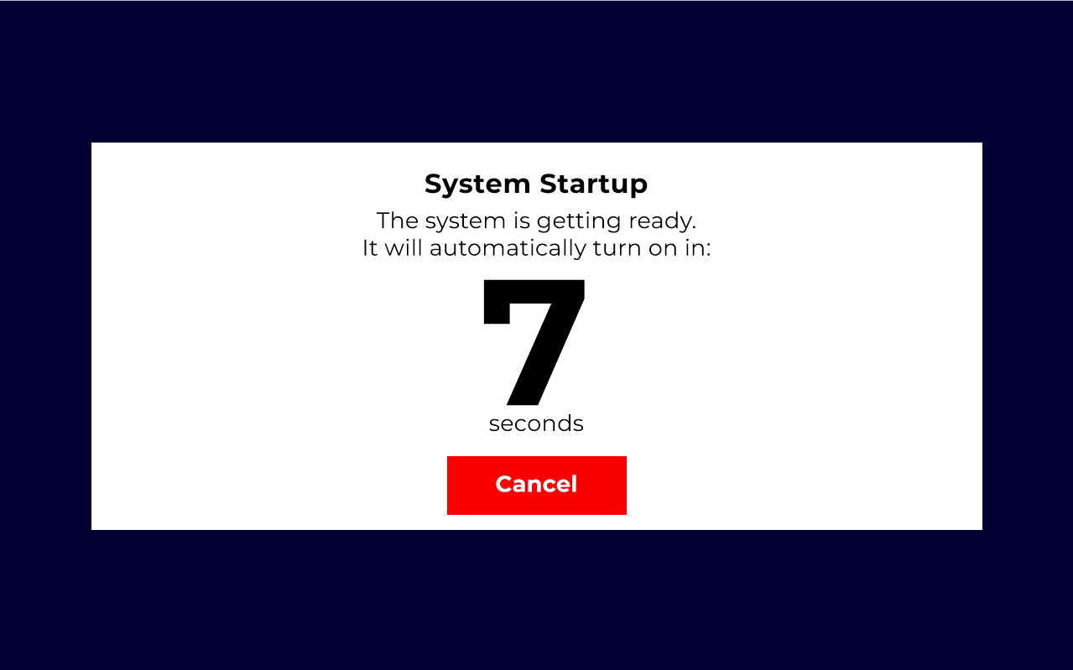

Slide 3
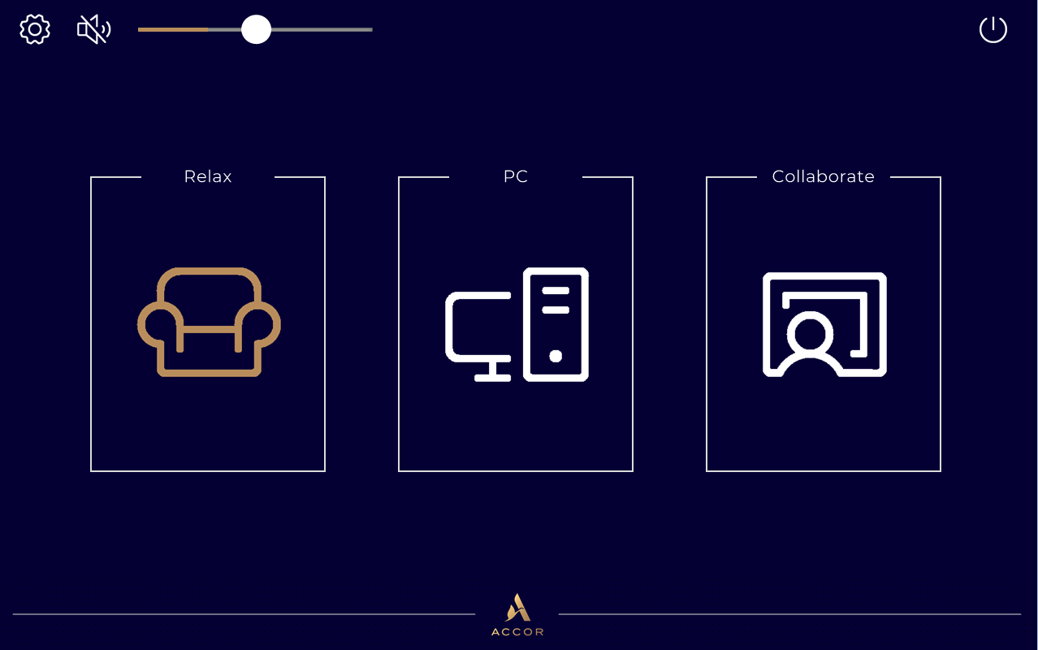

Slide 4
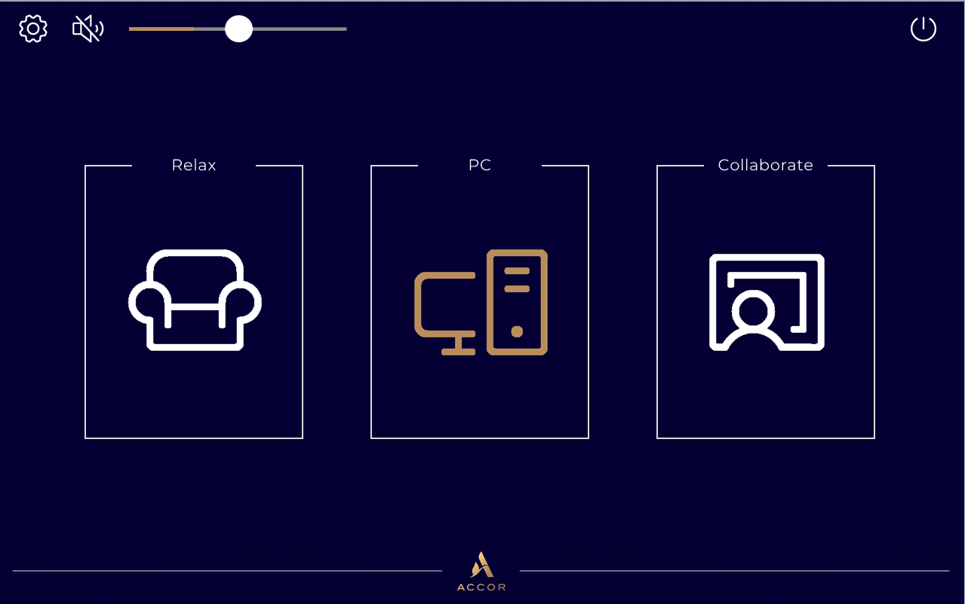

Slide 5
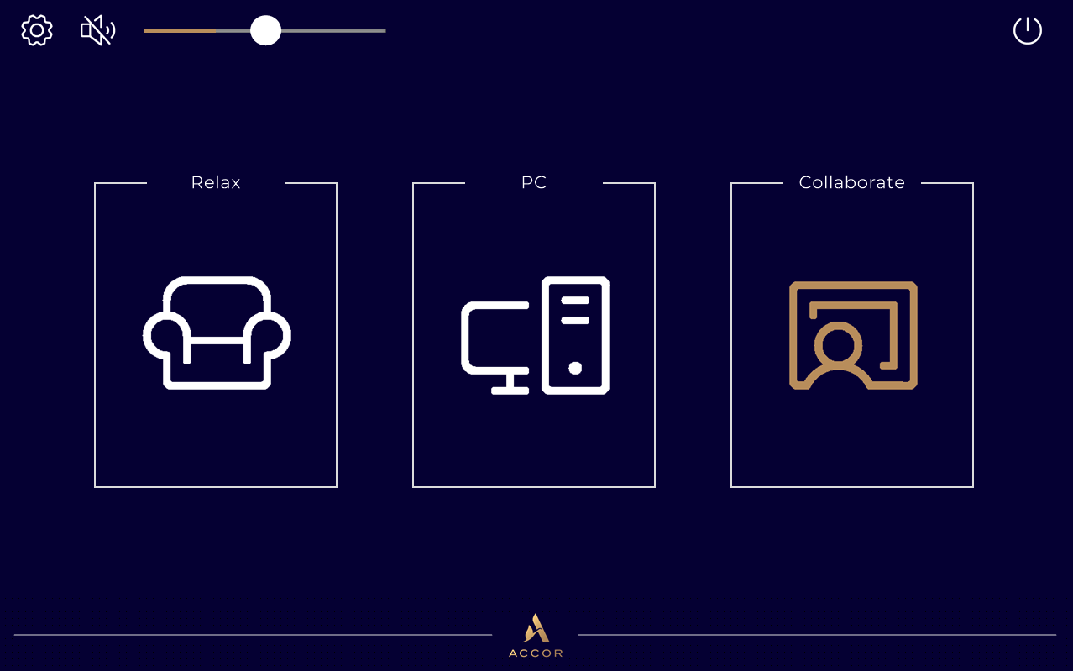

Slide 6
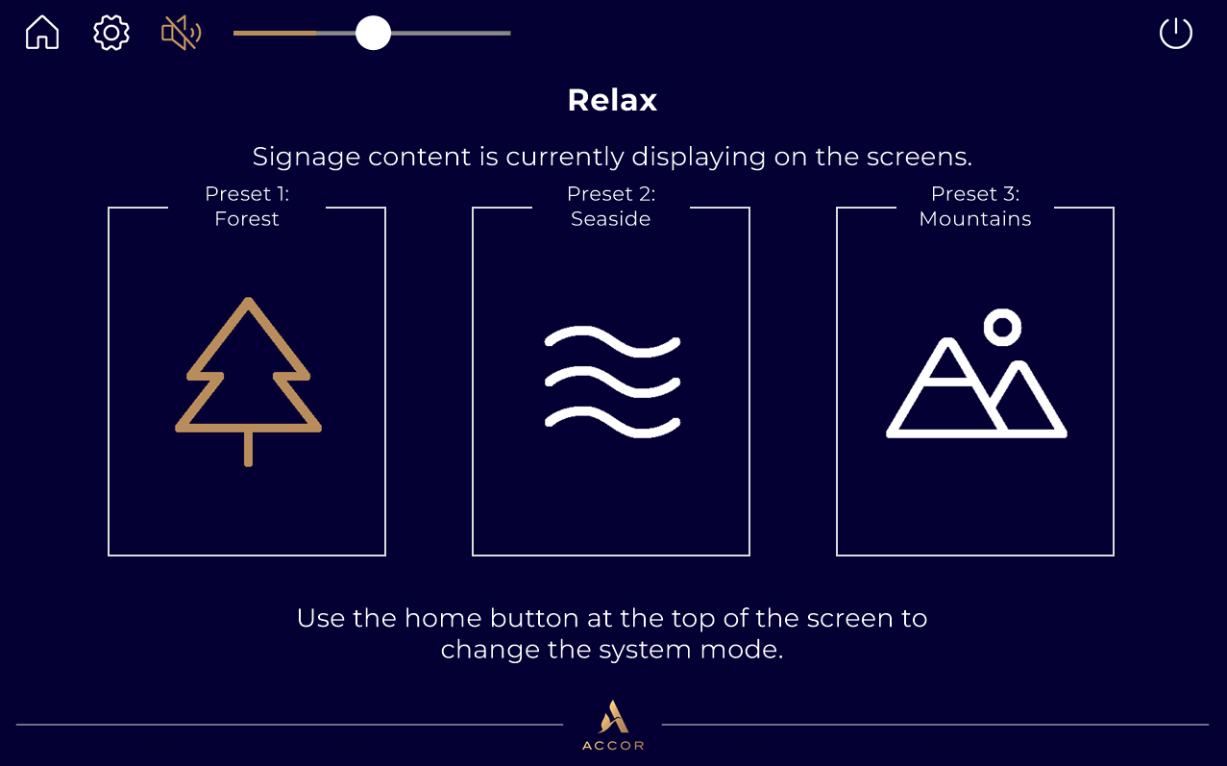

Slide 7
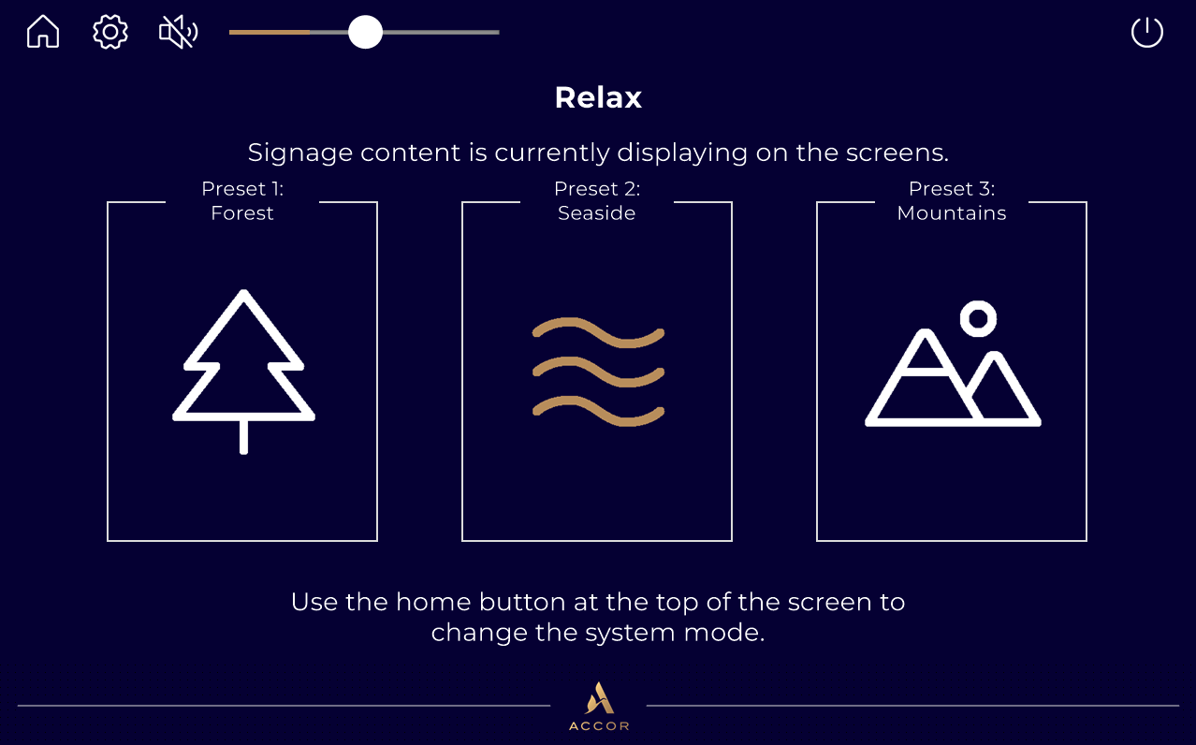

Slide 8
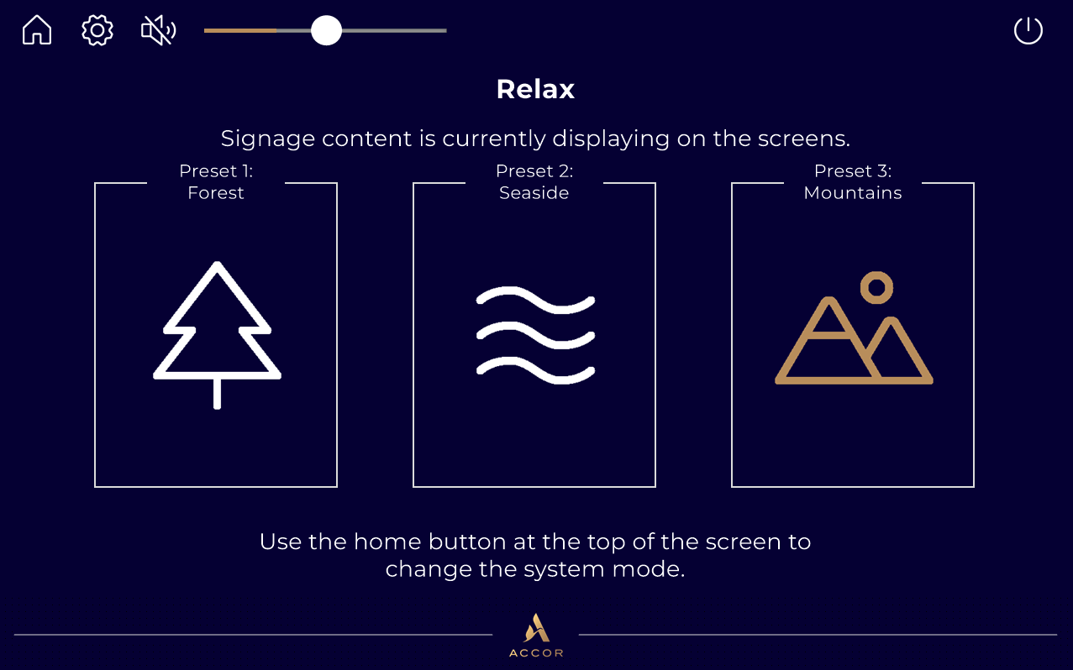

Slide 9
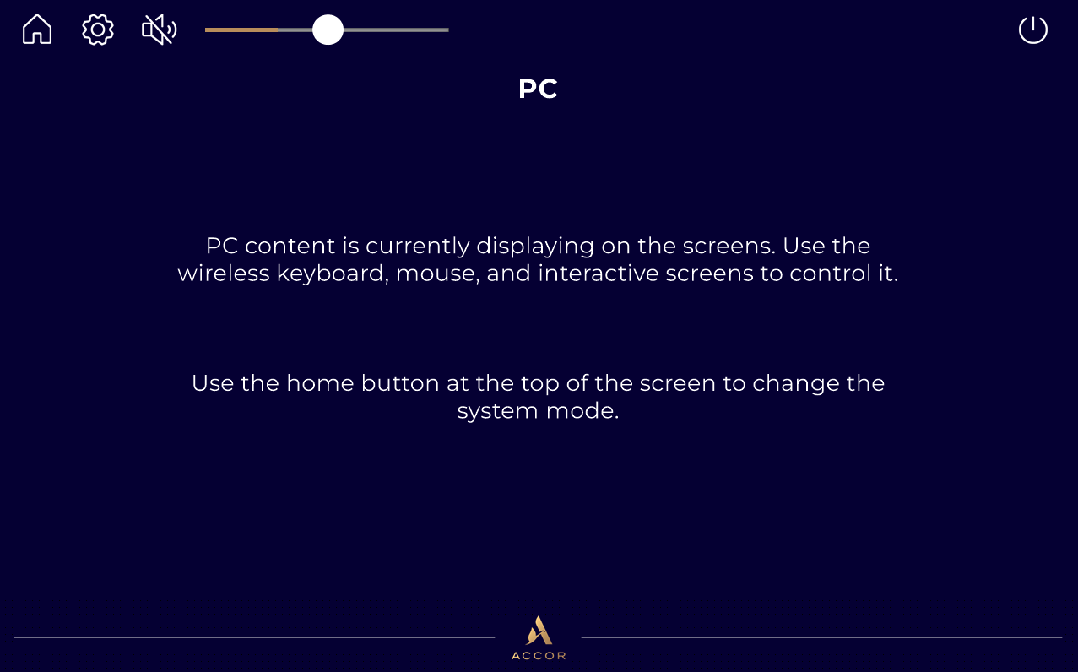

Slide 10
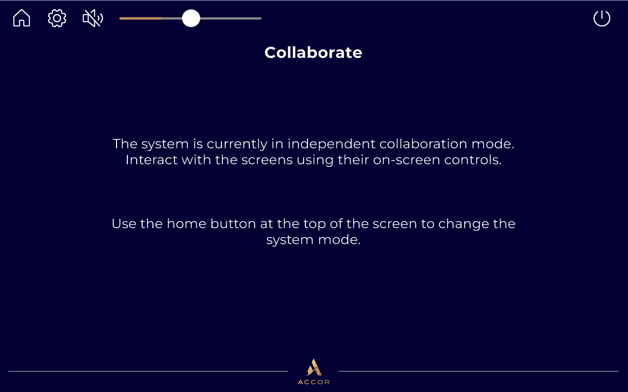

Slide 11
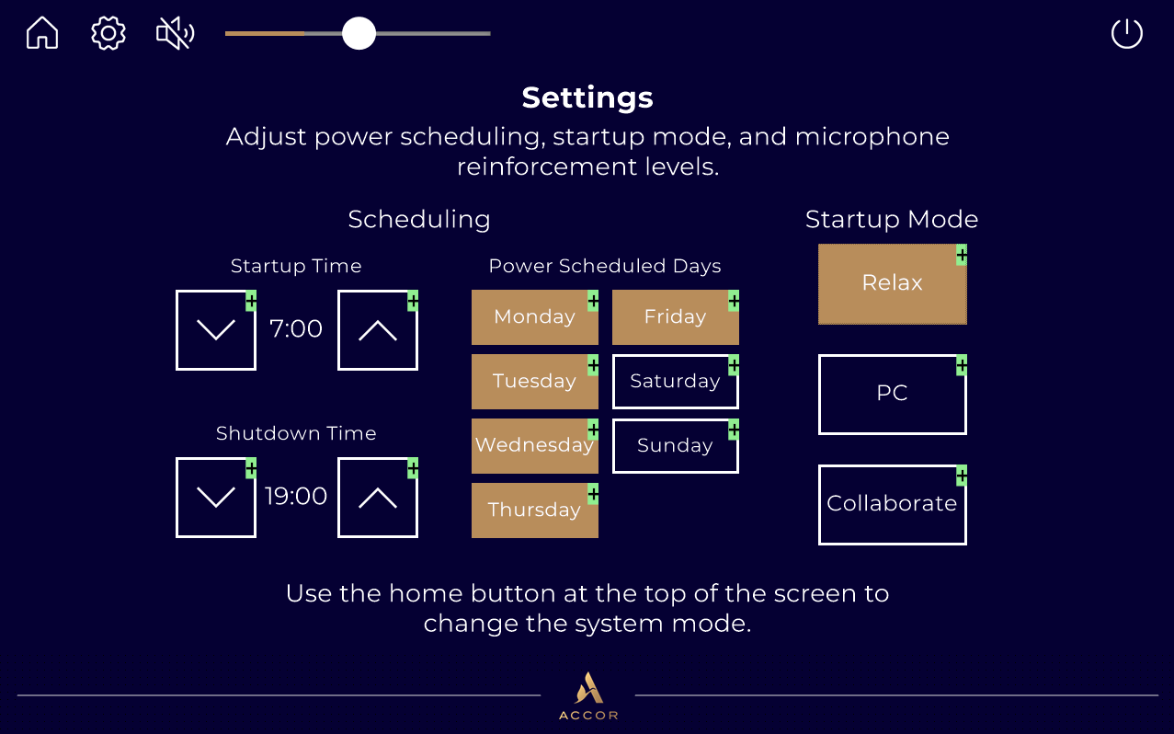

Slide 12
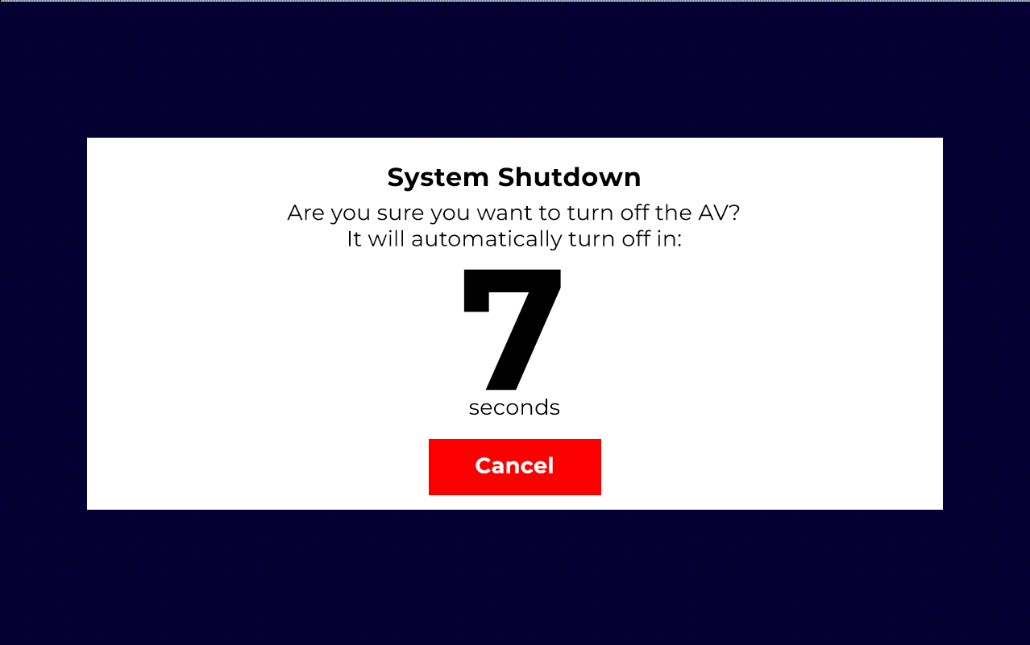

Slide 13


Slide 15
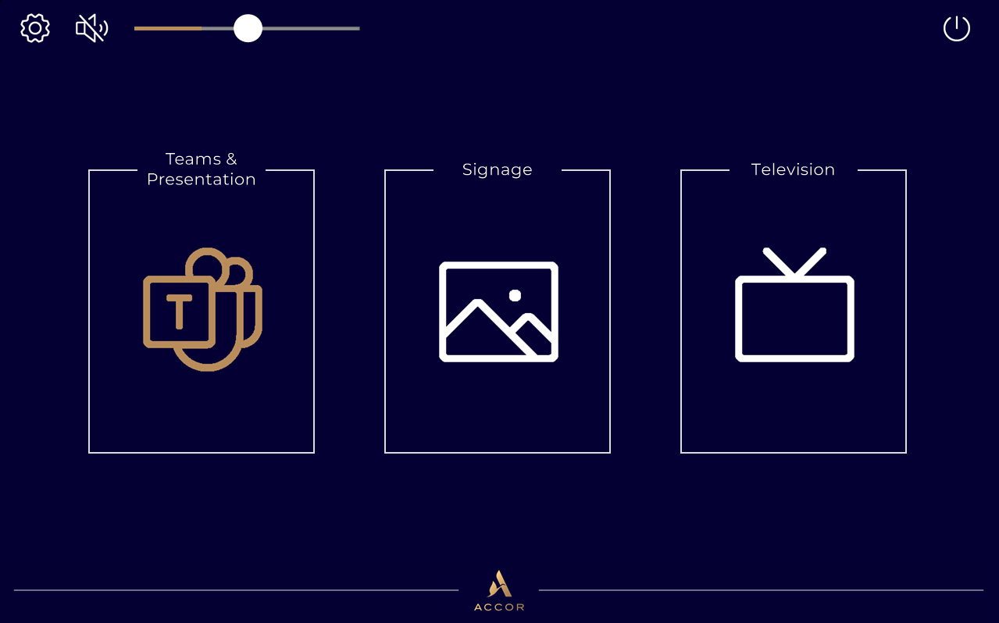

Slide 16
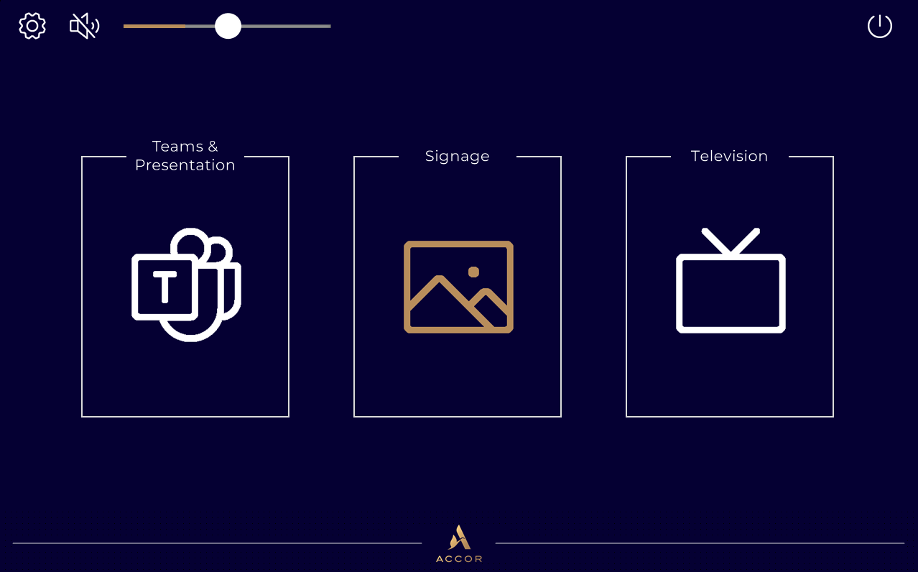

Slide 17
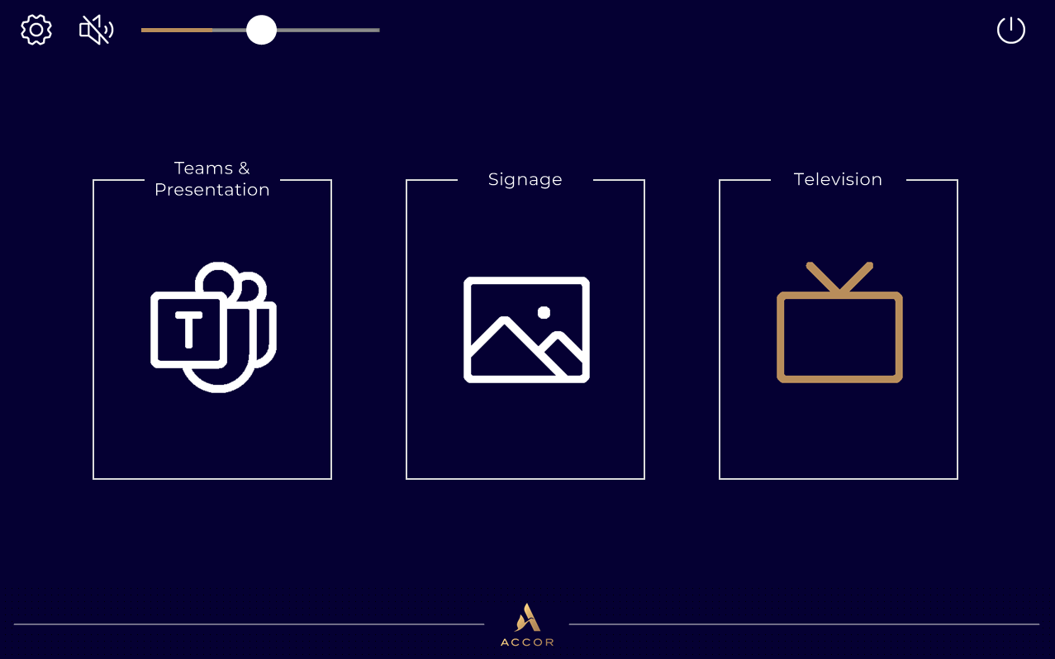

Slide 18
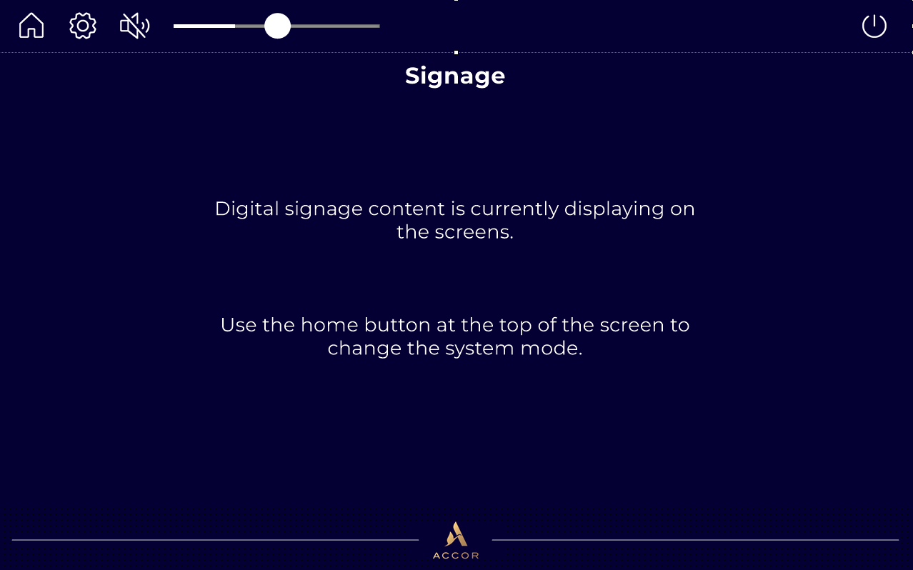

Slide 19
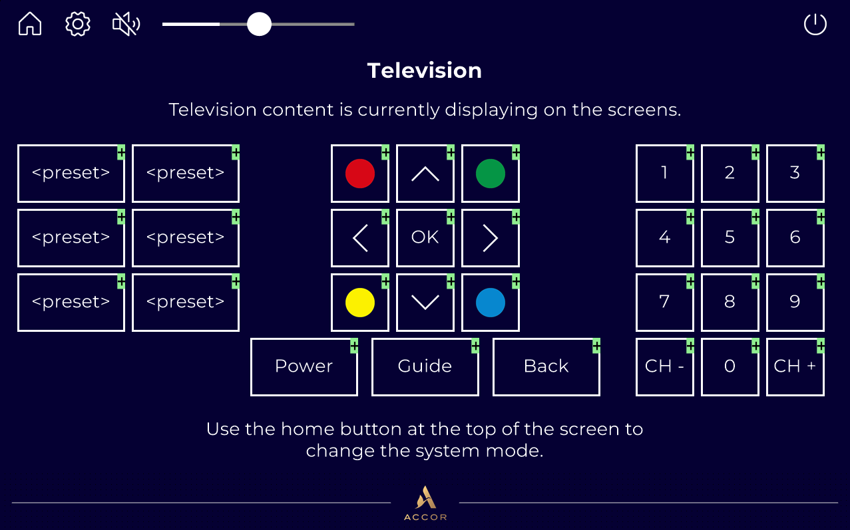

Slide 20
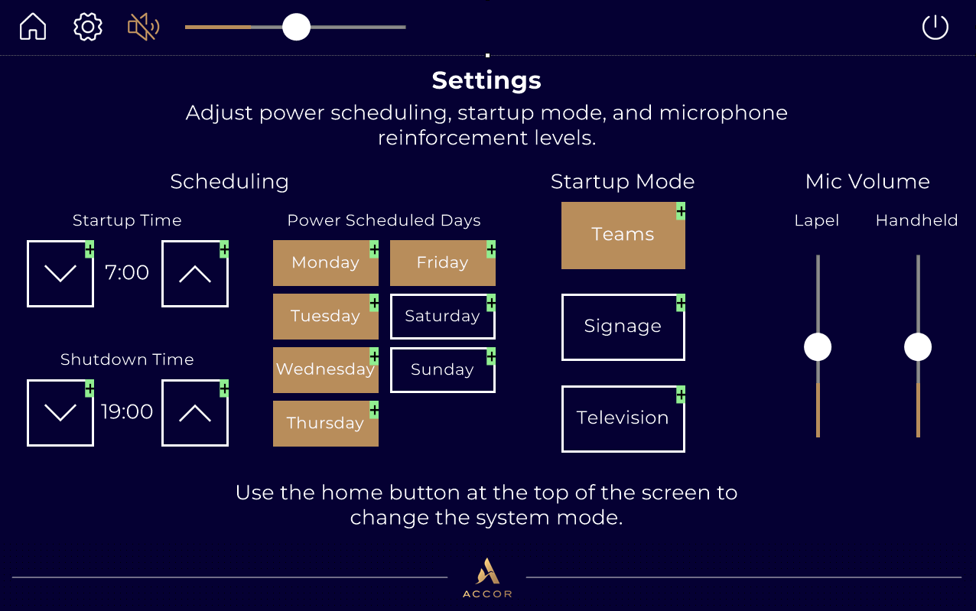

Slide 22
Development Notes
Development based on J23NA023-AVSPEC ROOMS-REV_04
Specification description of Multipurpose & Atelier is considered to have been superseded by section 4.1 of the above document
Faders set to minimum will also be muted to prevent unusable ‘quiet zones’ in fader ranges
Design artifacts such as green plus icons on buttons, partially filled gauges/sliders, selection borders, etc. are from the design software and will not appear in final product
Signage content to be provided by others

